Slide 1
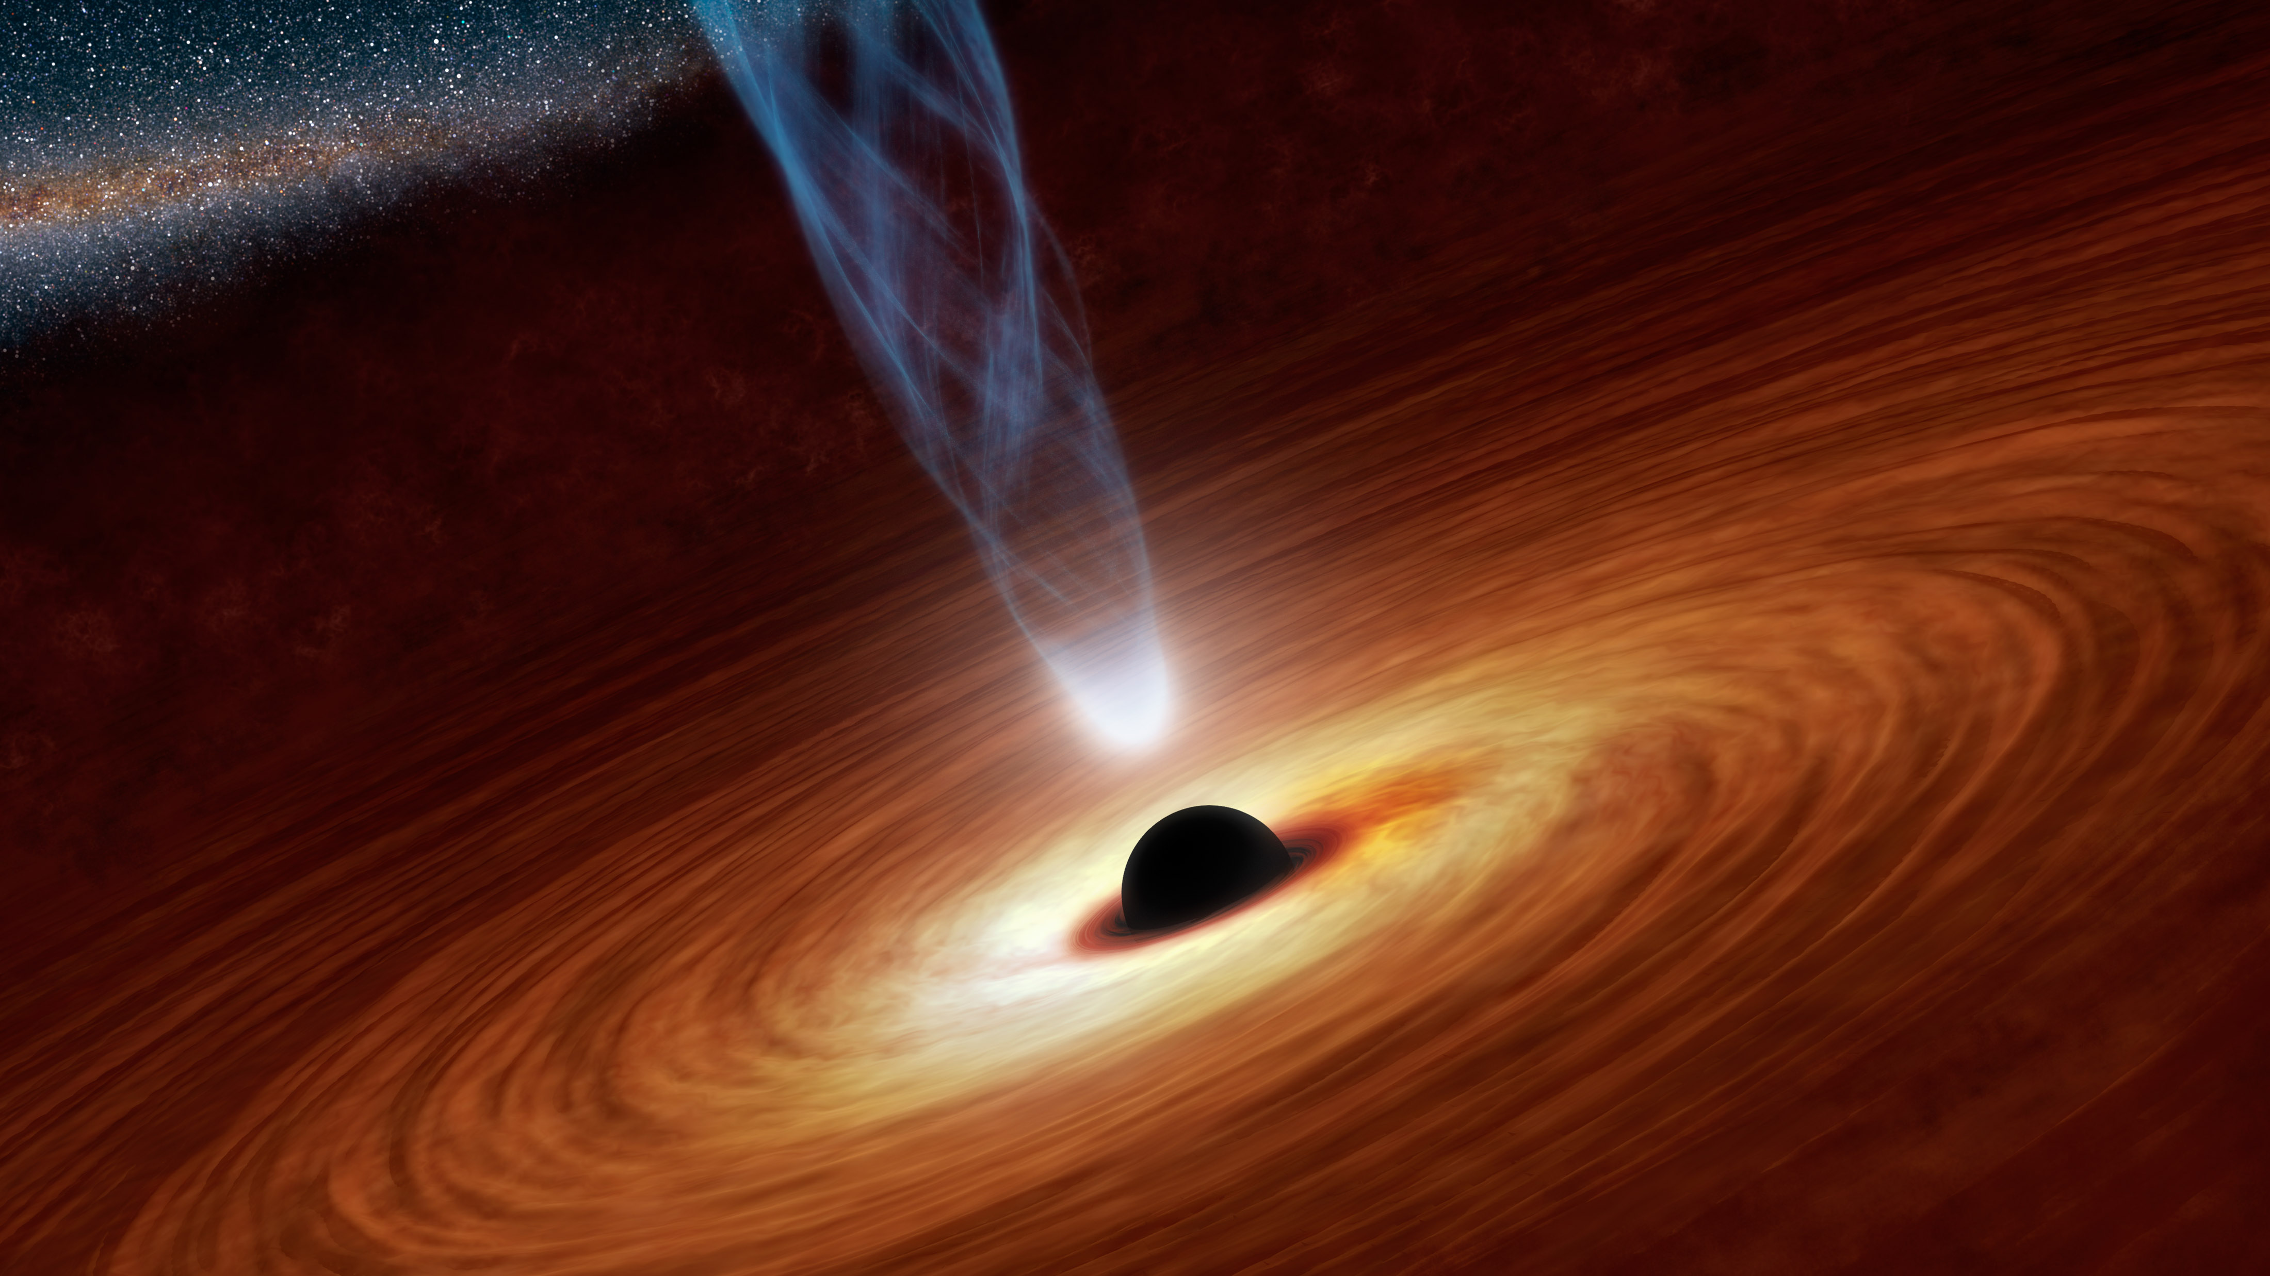
A Simulation for Black Hole Decay
By Jonah Saidian

Slide 2
Outline
Discussion of Hawking radiation both theoretically and through calculation
Introduction of my simulation and relevant results
Next steps

Slide 3

What is Hawking Radiation
Black holes are predicted to have some temperature inversely related to their mass
As a massive object with temperature >0 we expect some amount of blackbody radiation and this can be calculated
Hawking radiation is particularly intense for small and hot black holes of order <10^20 Kg

Slide 4
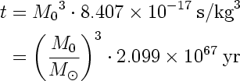

Implications of Hawking radiation
Hartle has an in depth analysis of the mathematics behind Hawking Radiation in chapter 13.3
One crucial consequence is that small enough black holes will have a lifetime and will actually decay in a time proportional to the cube of its initial mass
$M\left(t\right)={[3 v \overline{h} {(t}_{∗}−t)]}^{1/3}$

Slide 5
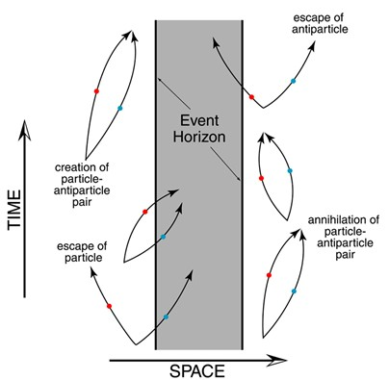
What is actually going on
The Theory behind what is happening is closely related to quantum mechanics
A pair of virtual particles is created near enough to the black hole in which one particle falls into the black hole and the other escapes
Hartle goes in depth about the math behind this and how this results in mass loss for the Black Hole
http://minerva.union.edu/diiorios/physics123/moreinfohawkingrad.html

Slide 6
Why simulate this?
I decided to write a simulation which would operate using the basic idea that particles created near enough to the black hole Schwarzschild Radius would cause the black hole to lose mass
The idea is to compare my simulation to the analytically obtained equations for Black Hole lifetimes through thermodynamics
I focus on Black Holes of mass order 10^5 Kg as these black holes have lifetimes of seconds and calibrate my simulation with a black hole of mass 5*10^5 Kg

Slide 7
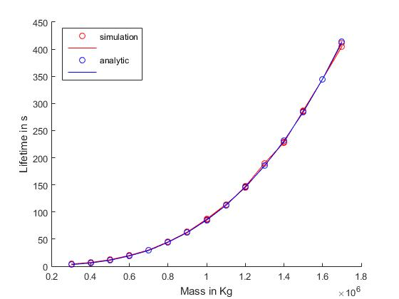
Some relevant Results
The simulation agrees very well with the predicted analytic results
A χ^2 analysis for one run of the simulation using 15 different masses yields an average χ^2 of .08

Slide 8
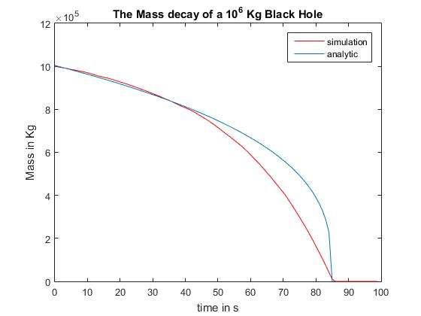
Individual simulation break down
Each simulation performs the lifetime analysis of a given mass black hole which can also be compared to mass function of a black hole over time
These results agree fairly well but are not as robust as the aggregate results due to the random nature of the simulation as well as imperfections in the simulation

Slide 9
Next steps
I would like to include the effects of CMB absorption into my simulation to make it a more accurate representation of what would actually happen
I was hoping to make an animation of the lifecycle of the black as it decays but unfortunately did not have the time to make it
I would like to improve the results of the individual simulation to line up more closely with the analytic results of the mass function

Slide 10
My simulation code
%a black hole of mass ~500,000 Kg has lifetime of order 10 s
m=1e6; %units of kg
m0=m;
c=3e+8; %units of m/s
G=6.67e-11; %units of N (m/kg)^2
R=2*G*m/c/c*10^(24); %units of yocto meters
R0=R;
m_loss=1e2; %lost mass per particle
N=ceil(1400 *(R0/741)^(-2) );
%number of particle interaction per second calibrated with m=5e5kg with
%l=11s and scaling with the changing radius
S=100; %number of seconds to simulate
mvec=zeros(S,1);
for t=1:S
mvec(t)=m;
p=[];
p=[3*R0*(rand(N,1).^2+rand(N,1).^2+rand(N,1).^2).^(1/2),rand(N,1)];
% the location of each collision and its acceptance probability
count=0;
for i=1:N
if p(i,1)>R && p(i,1)^3 < (1/p(i,2)*R^3)
count=count+1;
elseif p(i,1)>R && R/R0< p(i,2)
count=count+1;
end
end
m=max(m-m_loss*count,0);
R=2*G*m/c/c *10^(24);
if m<10
l=t;
break
end
end
T=0:S-1;
plot(T,mvec,'red')
hold on
%analytic solution
v=1/(15360*pi);
hb=1.05e-34;
a_l=ceil(8.407e-17*m0^3);
X=0:a_l;
mx=zeros(a_l,1);
for i=1:a_l+1
mx(i)=(1/(8.4e-17)*(a_l-X(i)))^(1/3);
end
plot(X,mx)
xlabel('time in s')
ylabel('Mass in Kg')

Slide 11
References
Formulas and Theory from Gravity: An Introduction to Einstein’s General Relativity, by Hartle
Image from http://minerva.union.edu/diiorios/physics123/moreinfohawkingrad.html
Useful gui for mass and lifetime comparisons on http://xaonon.dyndns.org/hawking/

